Slide 1



Evolution of
Tornado.cash protocol
Non-custodial privacy solution for Ethereum
Roman Storm
Roman Semenov

Slide 2

The importance of privacy
Blockchain is like a Twitter for your bank account
The lack of privacy can be a show stopper for businesses
Growing popularity of chain analysis tools already drives the need for on chain privacy
Privacy is a feature, not a product. We need privacy within the DeFi ecosystem, not on a separate privacy chain. Most privacy features are implementable directly on top of Ethereum. The current Tornado Cash implementation is just the first step.

Slide 3

Drawbacks
Fixed pool amounts are inconvenient
Execution on L1 is expensive. 1M gas cost for deposit and 400k for withdrawal

Slide 4

Tornado Cash stats
Over
Over
100,000
$500M
transactions
value locked
Over
$10M
~2%
daily volume
of all ETH has passed through tornado cash

Slide 5
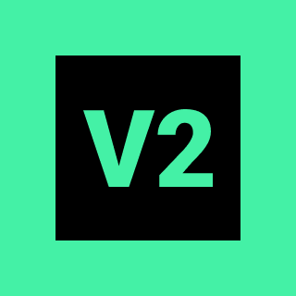

New version
Privacy pool with internal transactions
Arbitrary amounts
Shielded transfers within a single privacy pool
Uses Gnosis Chain under the hood
Currently Gnosis Chain is the only popular sidechain without bridge withdrawal delays

Slide 6
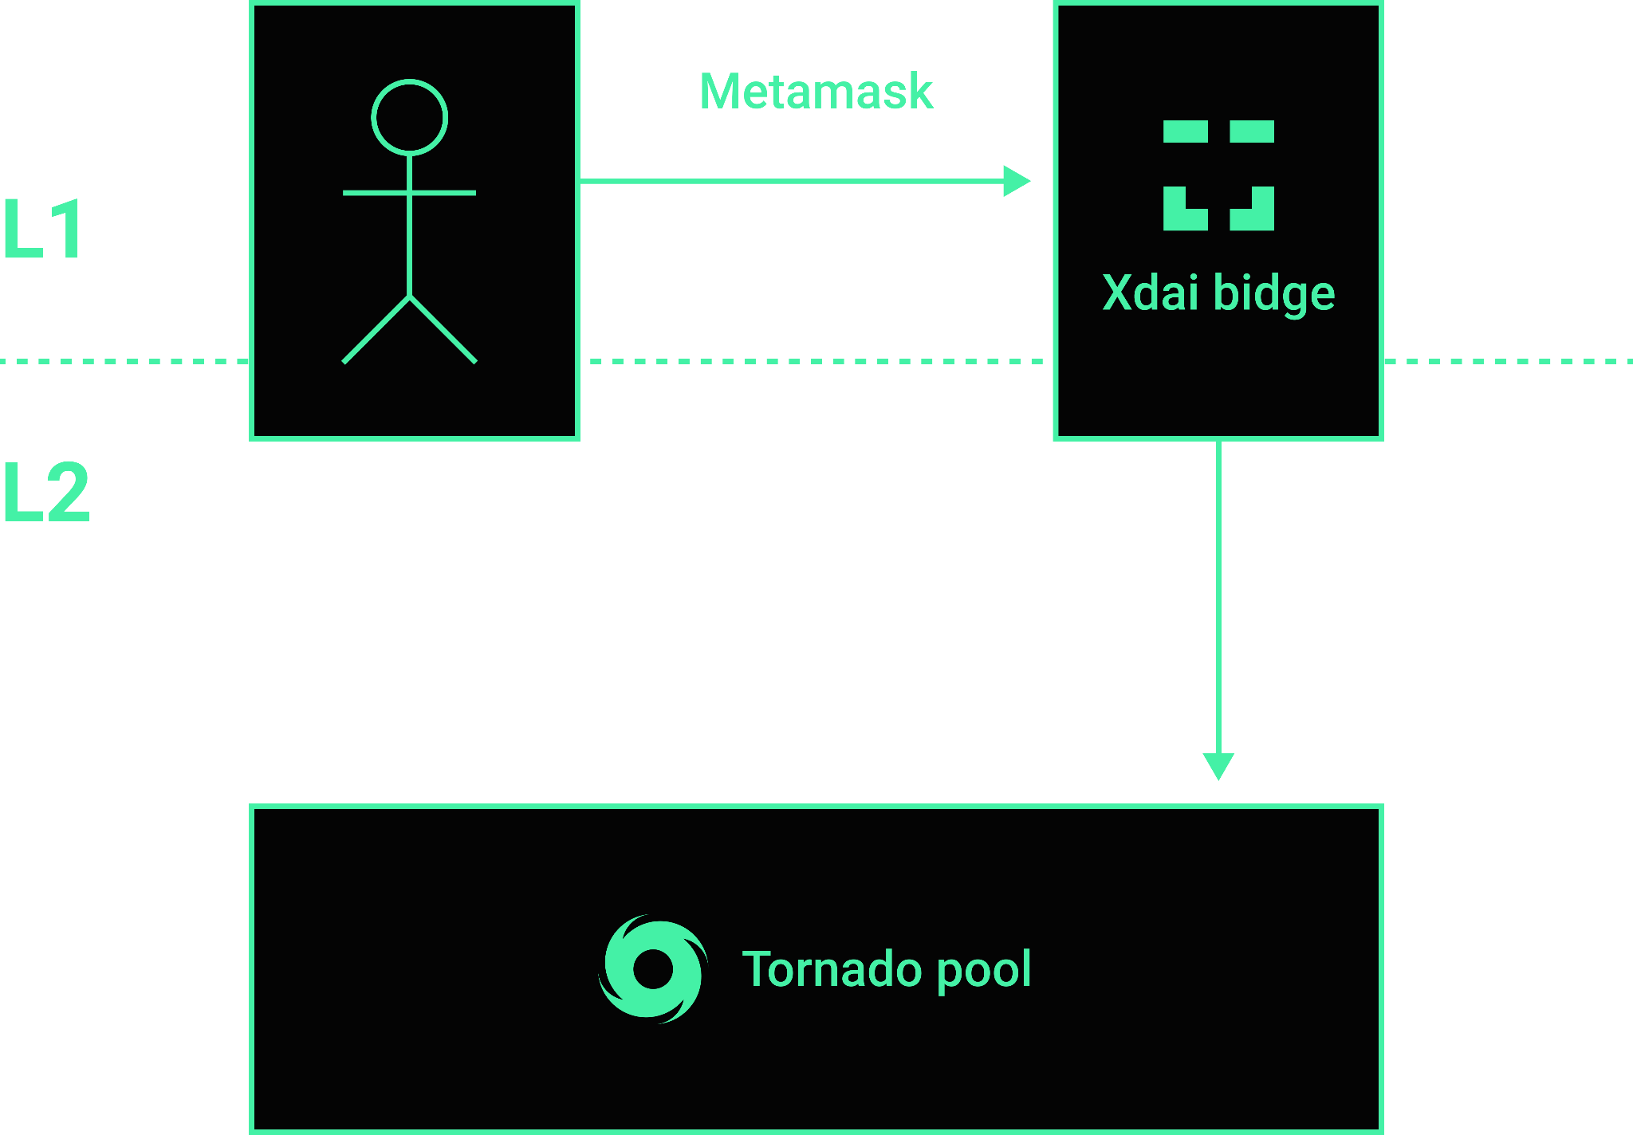
Deposit

Slide 7
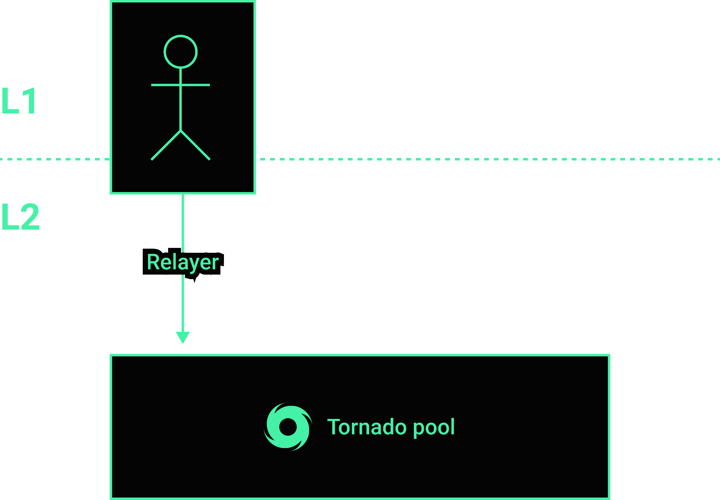
Shielded Transfer

Slide 8
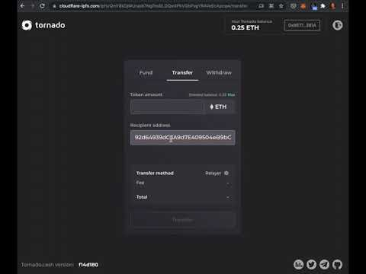

Slide 9
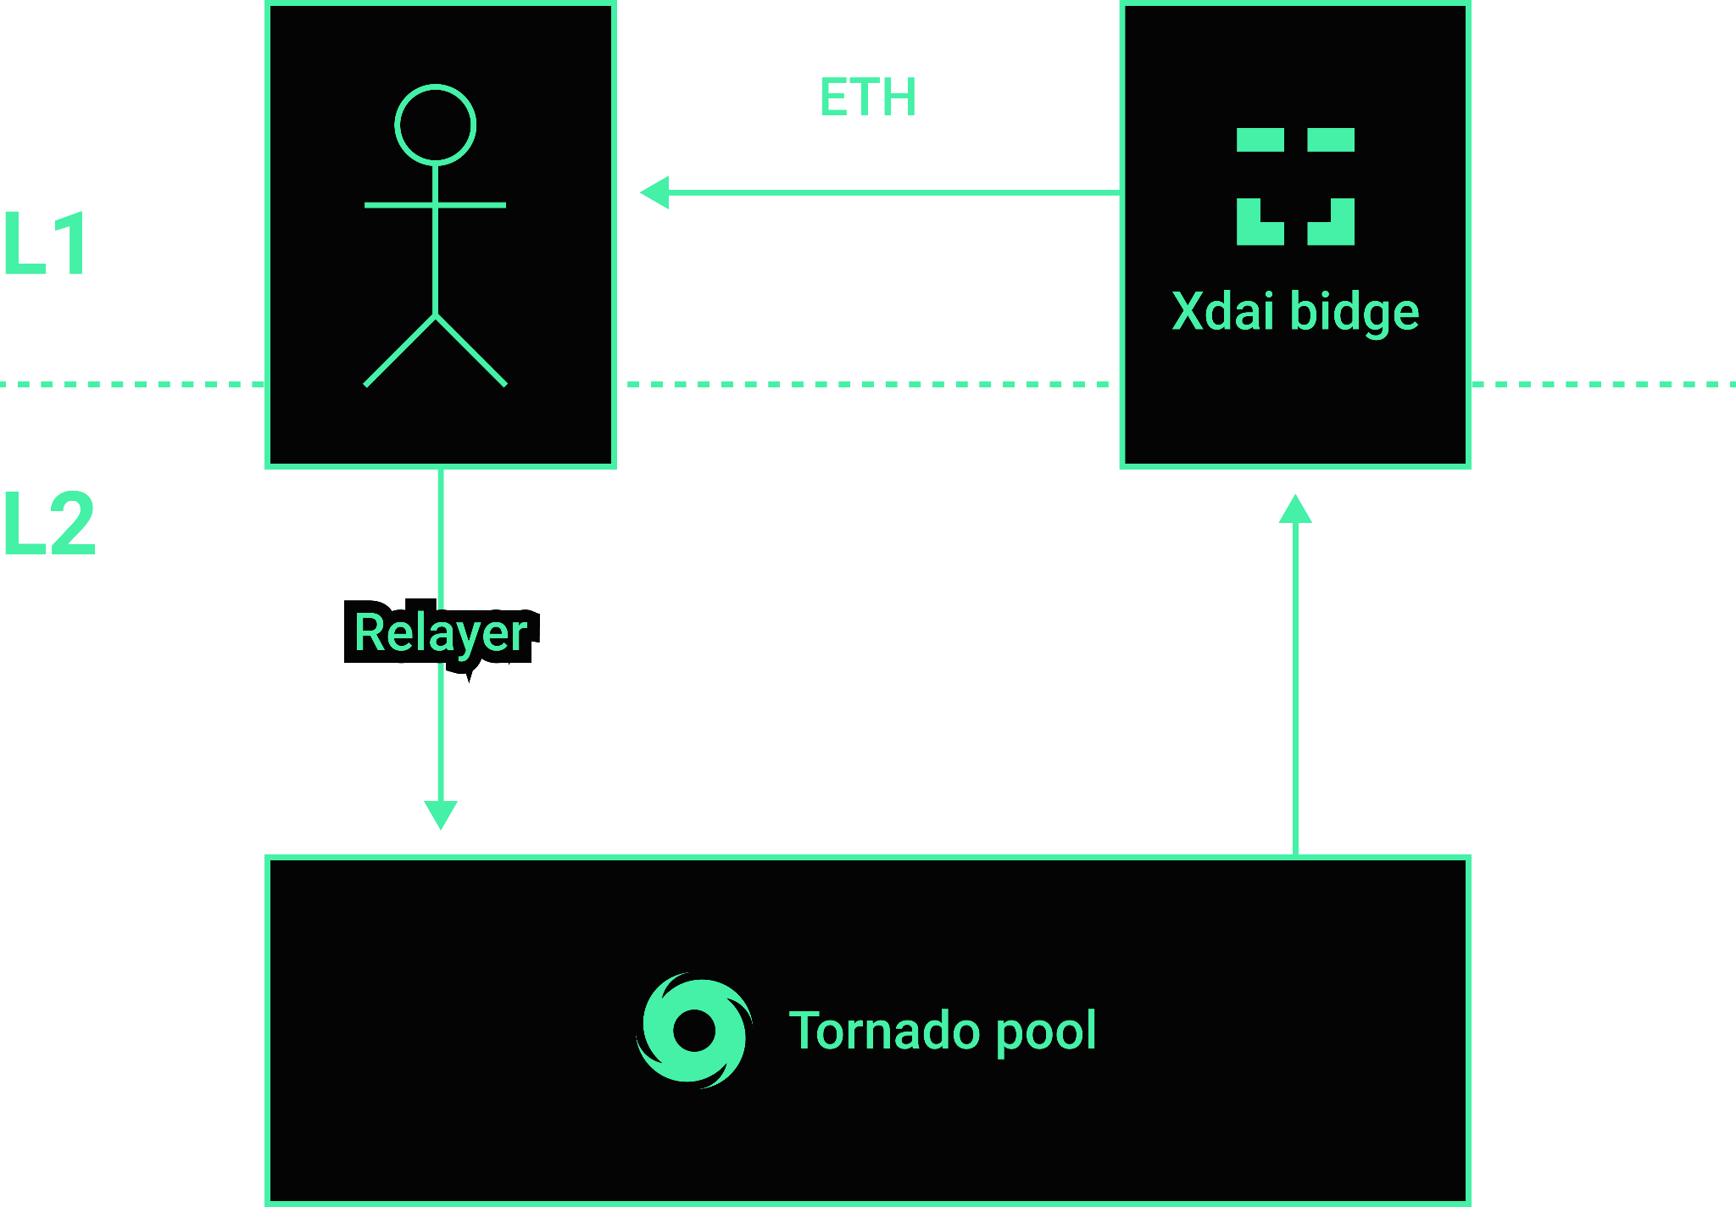
Withdraw

Slide 10
Tornado Cash Nova stats
Over
Over
5,000
Ξ3,000
transactions
ETH deposited
Over
3,000
$250k
Wallets registered
TVL

Slide 11


Planned features
ERC20 and ERC721 support
Shielded atomic swaps
Diversified addresses Infinite different addresses for a single private key
Viewing keys
compliance compatibility
Uses L2
a rollup
Tx fees are paid with a single unified asset

Slide 12

Questions?

